Slide 1
Longevity of current mines (Locm)
Project name: Optimized drilling, charging and blasting management systems, phase ii (LoCM WP2)
Braam Greeff, CSIR

Slide 2
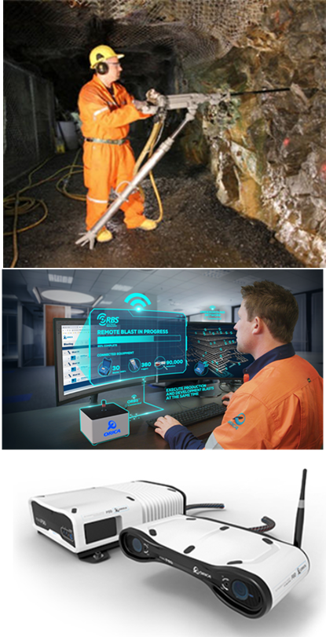

CONTENTS of report
Aim and objectives
Value to the industry
Phased approach
Focused areas of deliverables
Expected outcomes

Slide 3
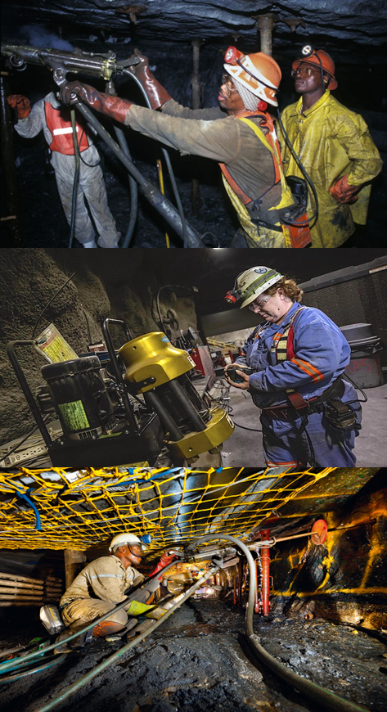
Aim and objectives
This PHASE II research project focusses on the conceptual realization of an integrated drilling, charging, and blasting laboratory-based solution for the RSA deep-mining industry

Slide 4
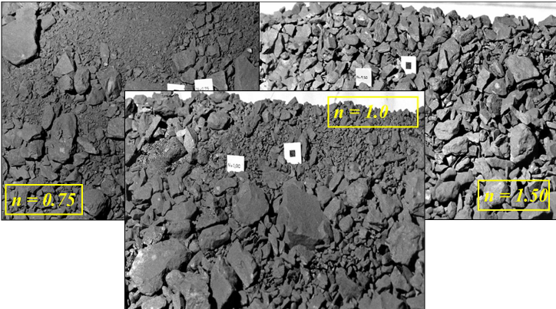
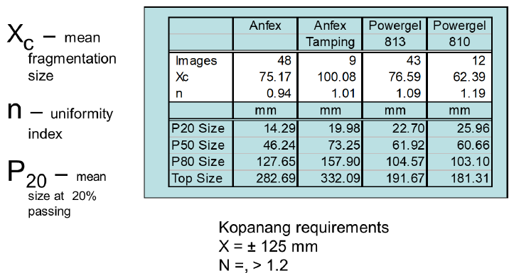
Value to the industry
An optimum drilling, charging and charging management system will enable , especially deep mining operations to mine with the optimum ore fragmentation size for maximum gold or platinum extraction losses.
An optimum blast design, with compliant drilling practices, and optimum drill hole charge filling capabilities, shall result in optimum blasting practices leading to optimum required ore fragmentation sizes.
The system shall enable optimum advance
Does not negatively affect the hanging wall.
Minimizes stope face time
Source: Jaco, Harmony

Slide 5
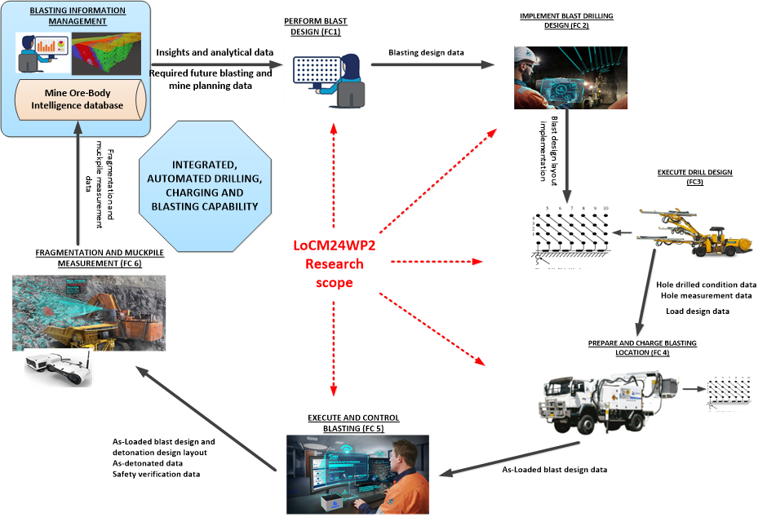
Historical “look-back” – previous phase 1
Focus was on mechanized mining
During the previous Phase 1 research stage (2023/24), the focus was on a mechanized mining operational context and use-case concept.
This integrated concept is not “as-is” suitable and directly applicable on deep gold mining operational requirements, although electronic interfaces could be adapted for deep non-mechanized gold mining operations.
There are no current OEM’s that could offer a fully integrated solution, still in development, hence this research

Slide 6


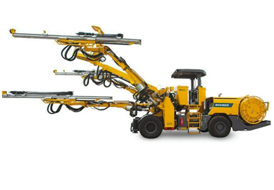
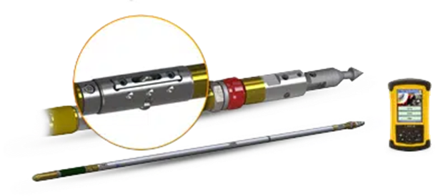
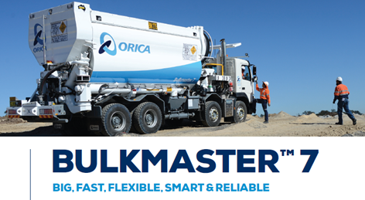
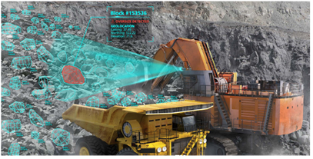
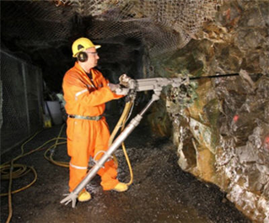
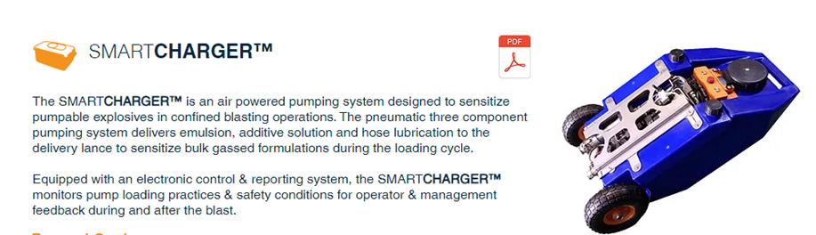
Some key issues identified during previous research stage
Mechanized mining (surface & underground)
Underground non-mechanized mining (gold)
Well ventilated spacious area vehicle access
Easy access to large mobile equipment
Easy access to the mining stope by large mechanized equipment
Drilling, charging of holes at the stope can be performed by automated mechanized mining vehicle systems
Information system connectivity available
No integrated mechanized system is currently available
No OEM is currently working on an integrated solution for non-mechanized operations
Tight spaces often at the stope-face
Usually, no access to the stope by large mining mechanized vehicle systems
Drilling and charging is often performed by manual means, performed by individual miners.
No or limited information system connectivity
Phase II Research focusses on non-mechanized context

Slide 7
Phased approach
Research outputs of PHASE 1 research work is used as inputs to define the functional requirements for PHASE II conceptual lab-system
A requirements baseline for PHASE II will be developed , which provides the key requirements for the development of the mining processes which will be implemented by the integrated lab-model.
PHASE I RESEARCH OUTPUTS ( 2023/24)
Requirements specification
Stope mining process definition
Integrate a lab-model
Report on findings

Slide 8
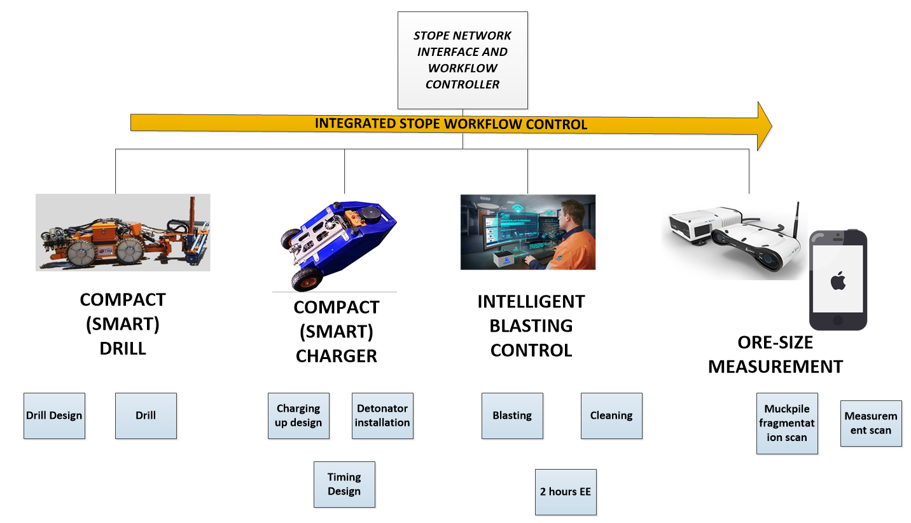
Expected outcomes
Integrated, portable stope drilling, charging, blasting & ore measurement capability
All sub-systems are integrated with a stope workflow controller sub-system

Slide 9
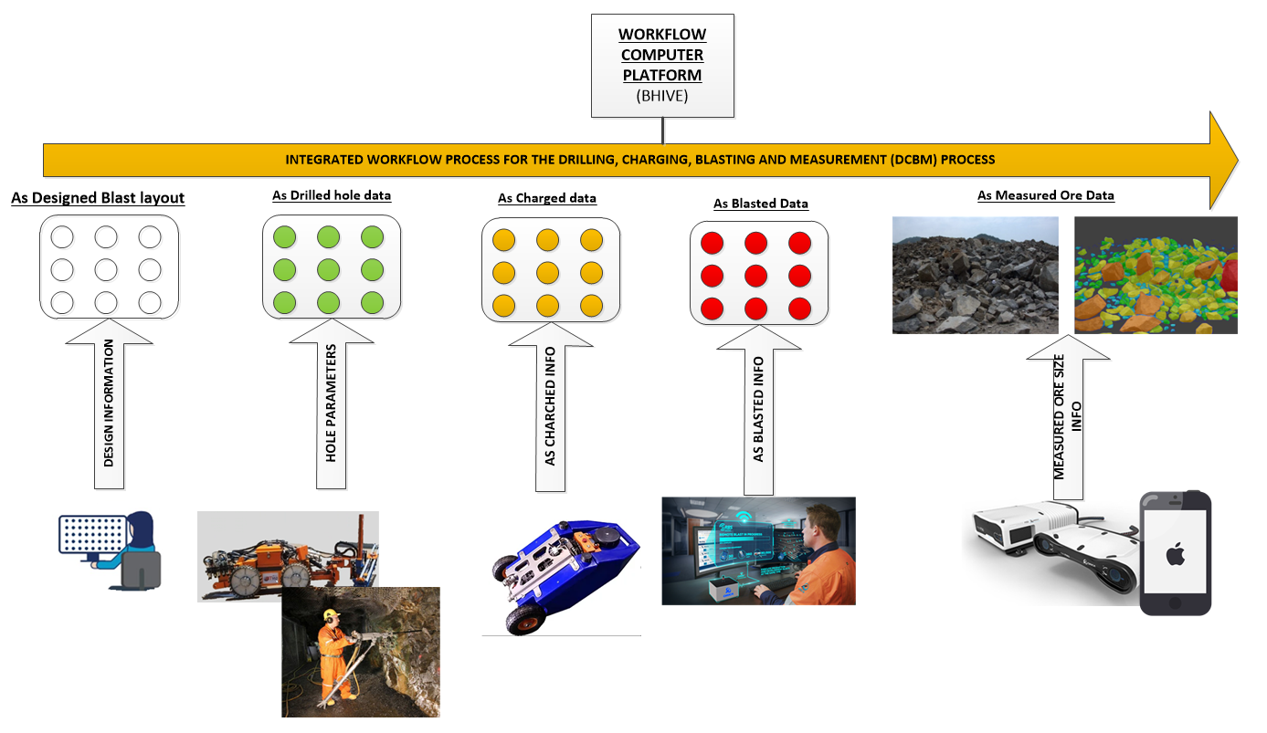
Expected outcome : stope mining workflow

Slide 10
Questions
Any questions?

