Slide 1
Mechanised Mining Systems (MMS)
Rock Engineering Pillar Design (Phase IV)
Enterprises University of Pretoria

Slide 2

CONTENTS of presentation
Table of Contents | Slide
Aim and Objectives | 3
Value to the Industry | 4
Phased Approach | 5
Example results | 6
Deliverables and Expected Outcomes | 7

Slide 3
Aims and objectives
Hard rock pillar reclamation considered hazardous - careful study of the risks associated with pillar reclamation is required
Importance of stiffness to assess the stability of bord and pillar mines
  Coalbrook disaster - pillar failure was violent and 4 000 coal pillars failed in a few minutes
  Welgedacht Colliery - the pillar failure was gradual
Different behaviour is caused by the stiffness of the pillars and the loading system
These parameters have never been quantified for hard rock mines.
  The objective of the project is to calculate stiffness parameters for different bord and pillar layouts using the TEXAN numerical modelling code

Slide 4
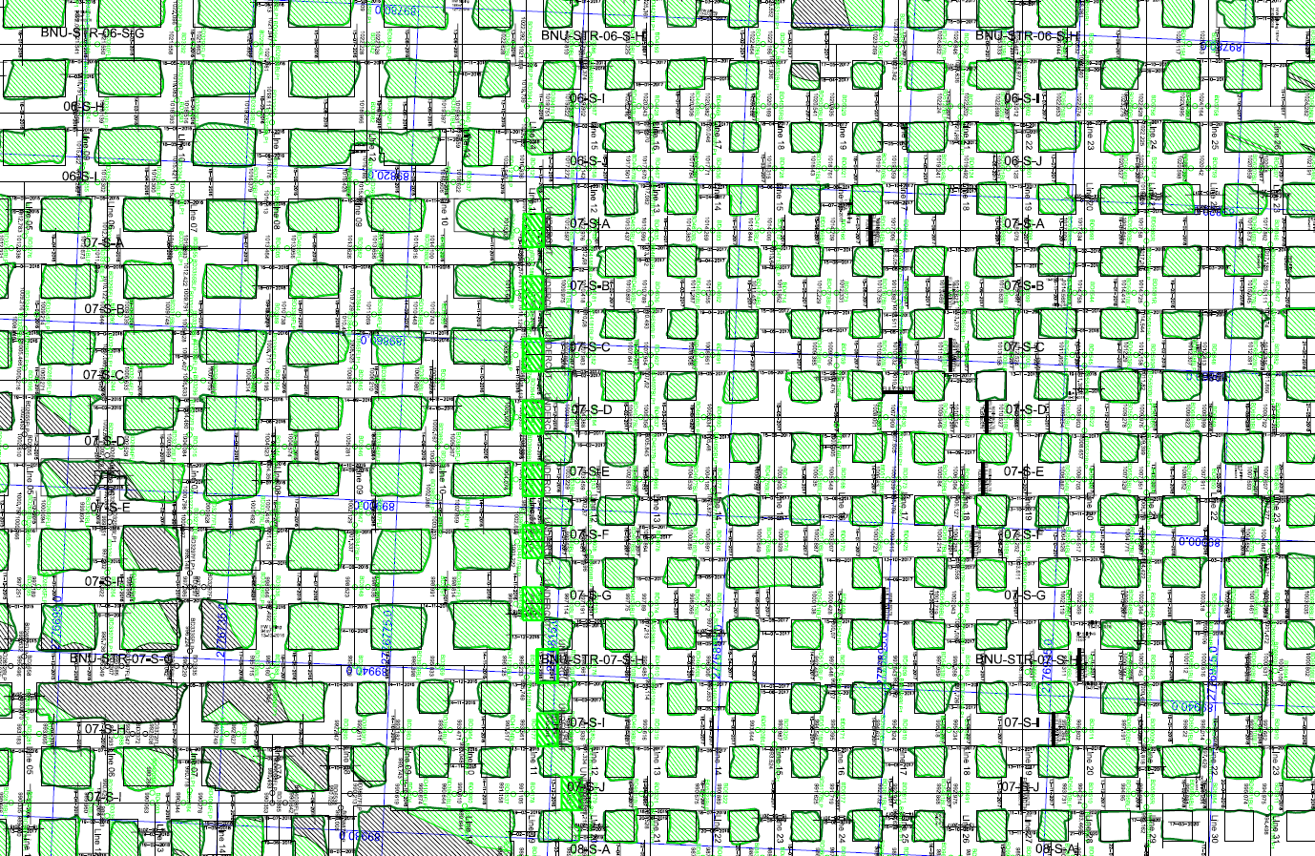
Value to industry
Prolong the life of some the mature operations
  Can pillars be safely reclaimed?
  What is the optimum extraction ratio
Improved assessment of the stability of bord and pillar operations
Improved pillar design methodology for bord and pillar layouts
Big pillars
Low extraction
Revised design
Higher extraction

Slide 5
Phased approach
Conduct a literature study on the use of stiffness calculations to assess pillar stability.
Explore the computation of stiffness parameters in the TEXAN code for bord and pillar layouts.
Conduct numerical modelling experiments on different pillar reclamation sequences and extraction ratios.
Develop a pillar reclamation guideline for projects where there is the intention to undertake pillar reclamation. This will include instrumentation

Slide 6
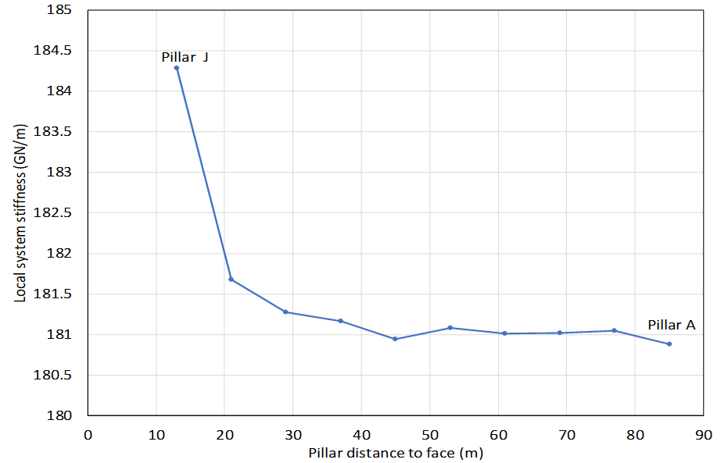
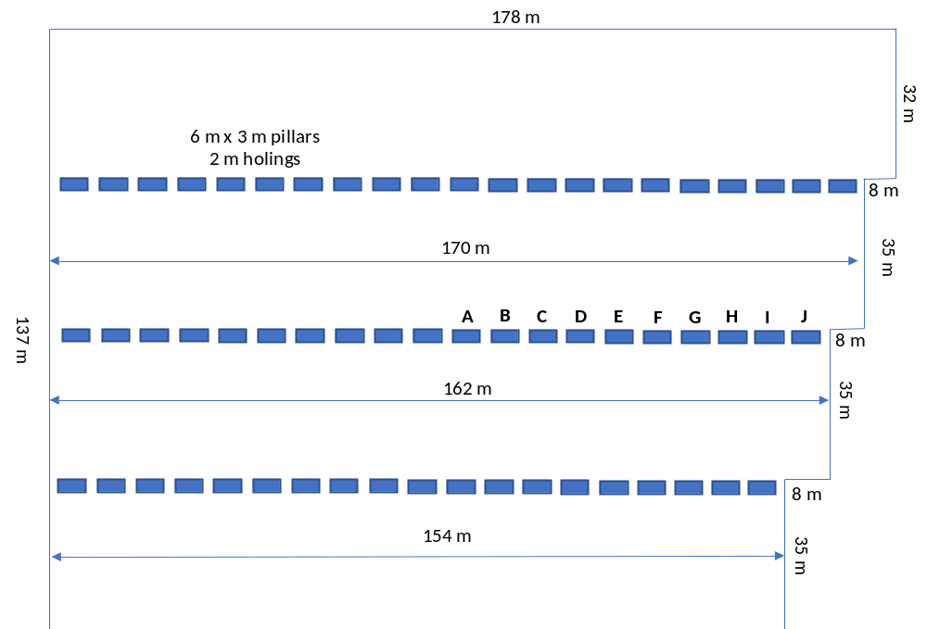
Example results

Slide 7
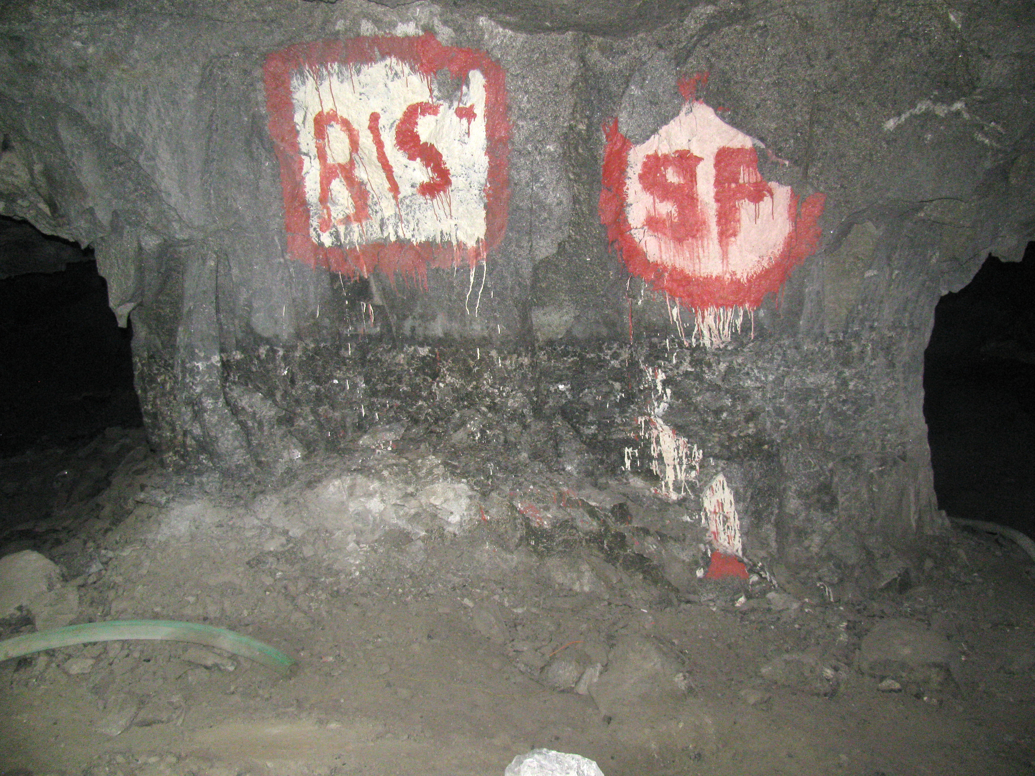
Deliverables and Expected outcomes
Improved understanding of stiffness concepts and parameters and their use to design bord and pillar layouts
Description of the methodology to calculate the stiffness parameters in displacement discontinuity codes
Improved guidelines for pillar reclamation strategies

